Slide 1
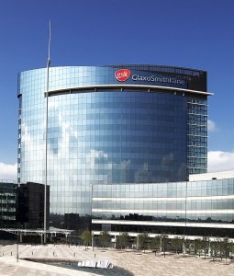
About me
Cristiano Maia
BSc Internet Application Development
Innovation Analyst in the R&D department

Slide 2
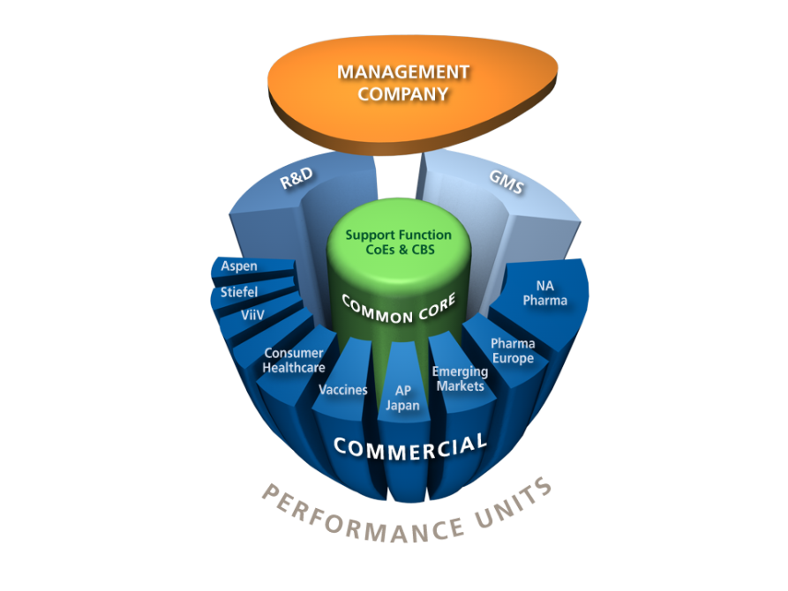
Placement Experience
Multinational team
19 in four different countries: England, USA, Bulgaria and Poland
Start-up style: Lean software development
Projects were used by 1 in every 5 employees around the world
Projects
Placement Communication team
Managing an international project
Organising Public Speaking Workshop
Technologies:
NFC
GPS
Beacon
Brain Reader
Smart Board
Google Glass

Slide 3
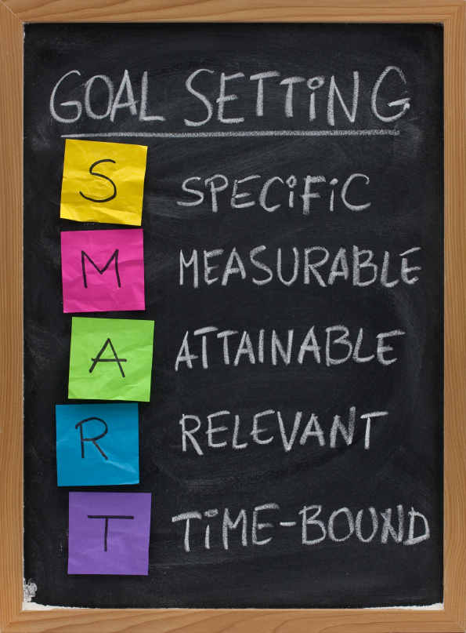
Self Development
Performance Development Planning
70% on–the-job development
20% Development relationships
10% Formal development
Training
Completed 34 courses. 59 hours total.
Performing and Leading with Integrity
Vendor Supplier Management for R&D IT
Introduction to the Web Application Development Standard (WADS)
Security Vulnerabilities and Complying with the WADS

Slide 4
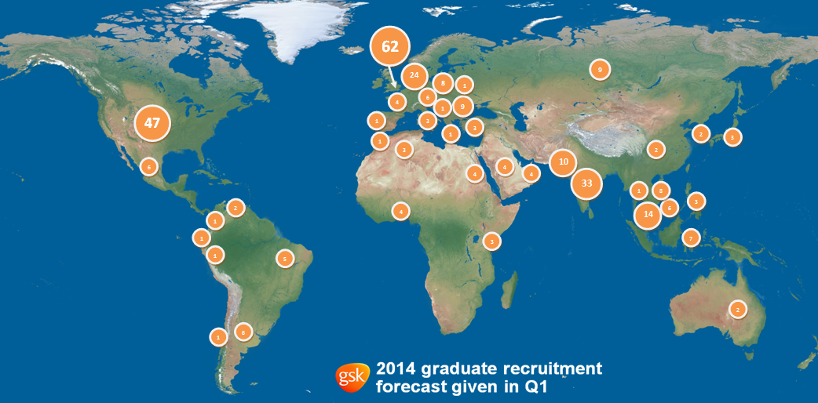
Graduate Opportunity

Slide 5
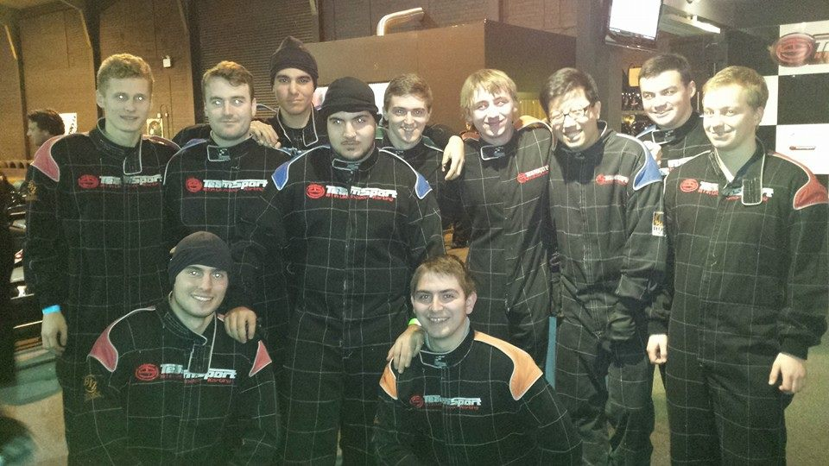
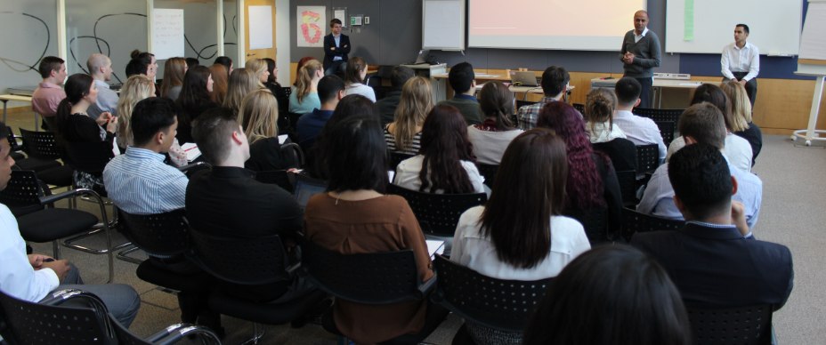
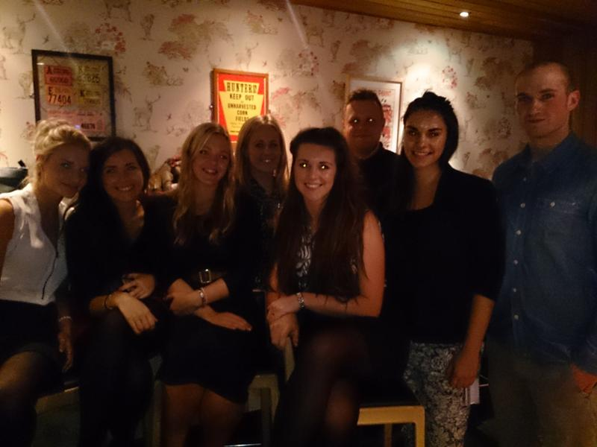
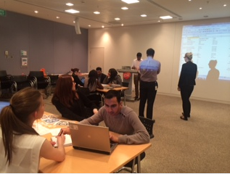
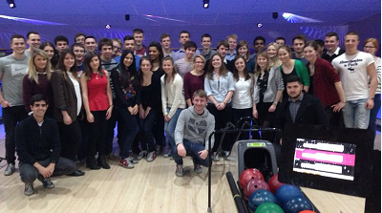
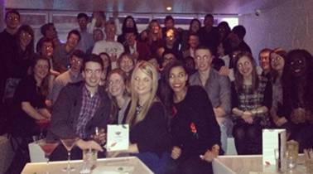
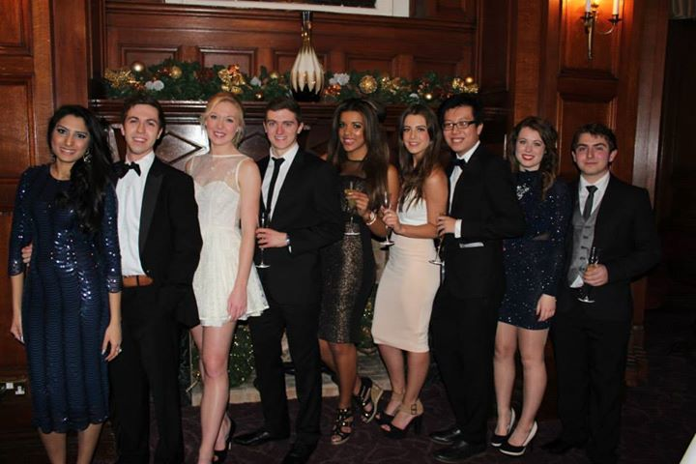
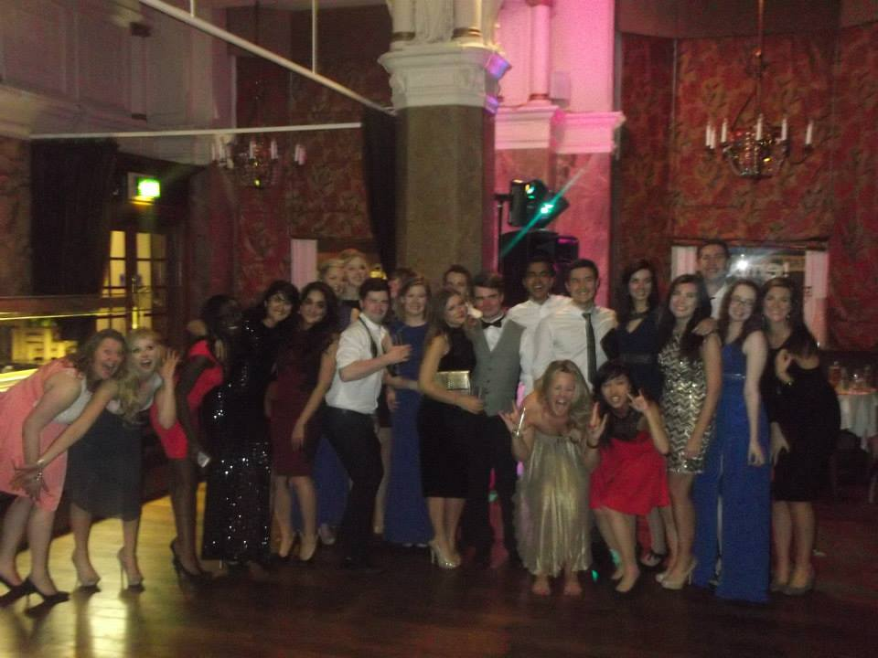
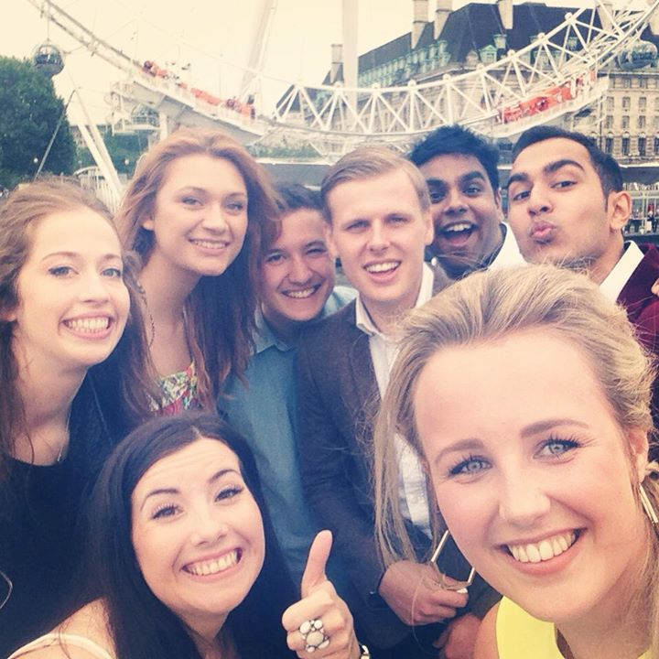
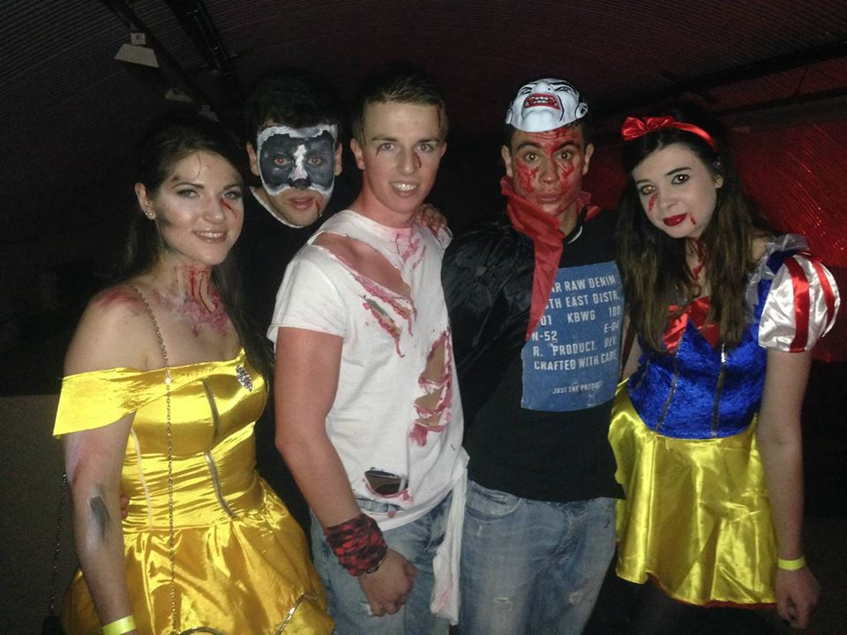
?

Slide 6
CC1177@LIVE.MDX.AC.UK Thank you

