Slide 2
Employability Forum: Introduction Computer Science Department School of Science and Technology Middlesex University
Tony Clark Professor of Informatics Head of Department Computer Science

Slide 3
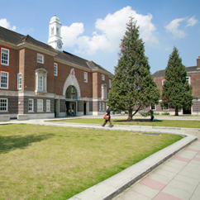
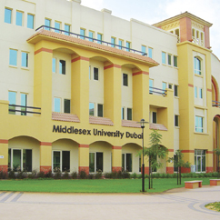
Middlesex University A Global Education
Campuses in London, Dubai, Mauritius, Malta
Students from over 100 countries worldwide
Internationally focussed teaching and research

Slide 4
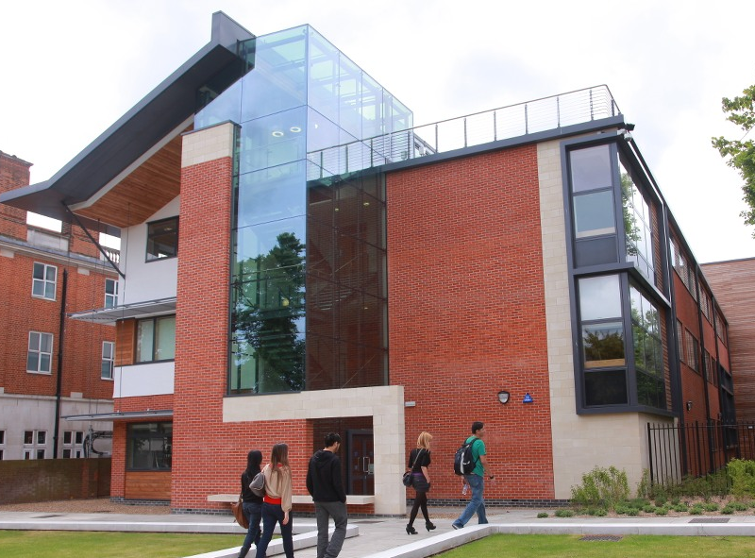
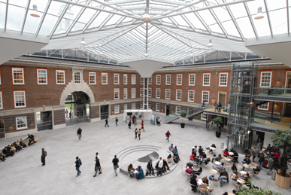
The Hendon Campus
One of London’s biggest campuses.
35,000 students in London and overseas.
Over £200million investment.
One of London’s biggest and best-equipped campuses.
Specialist teaching spaces, labs, studios and workshops.

Slide 5
Developing Careers
Ranked among the top ten universities for graduate salaries*
Taught by practitioners and professionals with links to industry
Embedded skills across our courses
Employability and Careers Centre giving specialist support on placements, part-time work or advice about career options from the beginning of courses.
Placements to enhance employability.
Student exchange programmes to study abroad – 100 in Europe and 30 more worldwide to choose from
Notes:
* Middlesex University has been ranked among the top ten universities for graduate salaries in research by an international consultancy firm.
The report, carried out by Parthenon Group, showed that Middlesex is better than most of the Russell Group institutions on employment outcome.
Middlesex, which came eighth, is in the top ten list along with LSE, Imperial College London, Cambridge, Oxford, UCL, Warwick, Kings College, Surrey, Bath and Bristol.

Slide 6
Computing
This is a broad area covering UG and PG:
Computer Science
Business Information Systems.
Information Technology
Computer Networks and Communications
Computer Forensics
Computer Systems Engineering

Slide 7
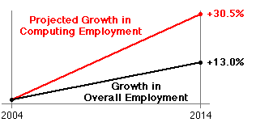
Demand

Slide 8
Computer Science Research
Largest Research area within the University.
Many strong links nationally, internationally and also with UK industry. (We have funded projects with Oxford, Imperial, UCL, Warwick, LSE, …)
International collaborations e.g. India, USA, Germany, etc.
REF return for CS of approx 55 staff.

Slide 9
RAE 2008 Power Rankings

Slide 10
Indicative Areas
Intelligent Environments
UK Visual Analytics Consortium (CRISIS, VALCRIE)
Rehabilitation Robotics
Anti-terrorism Forensics
Philosophy of Computing
Verification and Validation (NASA)
Computational Modelling (RNA Biological Structures)
Quantum Computing
Information Systems Modelling (Model Driven Org)
AI, Understanding Human Behaviour
Computer Ethics

Slide 11
Welcome.
Enjoy the Forum.

