Slide 1
Departmental Employability Strategic Framework (DESF)
Computer Science Department
School of Science and Technology

Slide 2
Employability vision
Increasing student
Placements
Internships
Exchanges
Supporting students towards graduate jobs
Establishing strong links with alumni
Deploying projects in association with industry
Increasing awareness of current job market
Supporting student development
Offering career services

Slide 3
Employability support services
Opportunities (placements / internships / graduate jobs)
Science & Technology Employability Forum (STEF)
Science & Technology Employability Networking (STEN)
Science & Technology Employability Presentations Series (STEPS)
Employability projects
Volunteering
Student competitions
Mentoring

Slide 4
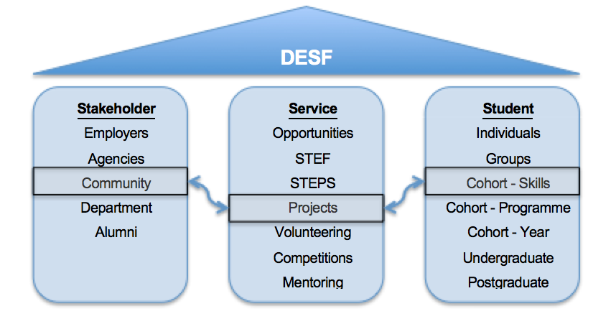
Departmental Employability Strategic Framework (DESF)
Case study:
Supporting knowledge transfer to local community
Deploying a project on Web 2.0 / Internet / e-commerce training
Involving students as trainers in a series of hands on demonstrations

Slide 5
Science & Technology Employability Forum (STEF)
Session 1 (09:45 – 11:30)
Theme: “What we look for… Are you ready to join us?”
Objective: Provide students with a reality check about the industry’s requirements
Session 2 (01:45 – 12:00)
Theme: “A taste of the 'real world’… My typical day at work”
Objective: Inspire students to take up work placements within similar companies/offering exposure to similar roles
Session 3 (12:00 – 12:30)
Theme: “What jobs are out there?”
Objective: Raising awareness about labour market needs
Session 4 (12:30 – 13:00)
Theme: “What will get me that job?”
Objective: Raising awareness about the recruitment process

Slide 6
Science & Technology Employability Presentations Series (STEPS)
December 3 – Ashley George, GSK
January 14 – TBC, (3 speakers)
February 4 – TBC, KPMG & EY
March 4 – TBC Fujitsu & L’Oreal
April 1 – John Kinchen, IBM
May 6 – TBC (3 speakers)

